Slide 1
Introduction to HCI
Week 1

Slide 2
Some definitions - What this course is about
Human Computer Interaction
– is the study of interaction between people and computer-based systems
– is concerned with the physical, psychological and theoretical aspects of this process
A discipline concerned with the design, evaluation and implementation of interactive computing systems for human use and with the study of the major phenomena surrounding them.

Slide 3
What types of system are we talking about?
Computer workplaces
Technical appliances
Instructional systems
Entertainment systems
Communication systems
Ecommerce systems

Slide 4
The "systems" are not all "computers" in the usual sense
In addition to studying the interaction, we will be studying the design process

Slide 5
What is Interaction Design?
Designing interactive products to support people in their everyday and working lives.
The design of faces for human communication and interaction.

Slide 6
Goals of Interaction Design
Develop usable interactive products
–Usability means easy to learn, effective to use and provide an enjoyable experience
Involve users in the design process
There’s a difference between building the
thing right & building the right thing!

Slide 7
Why does it matter?

Slide 8
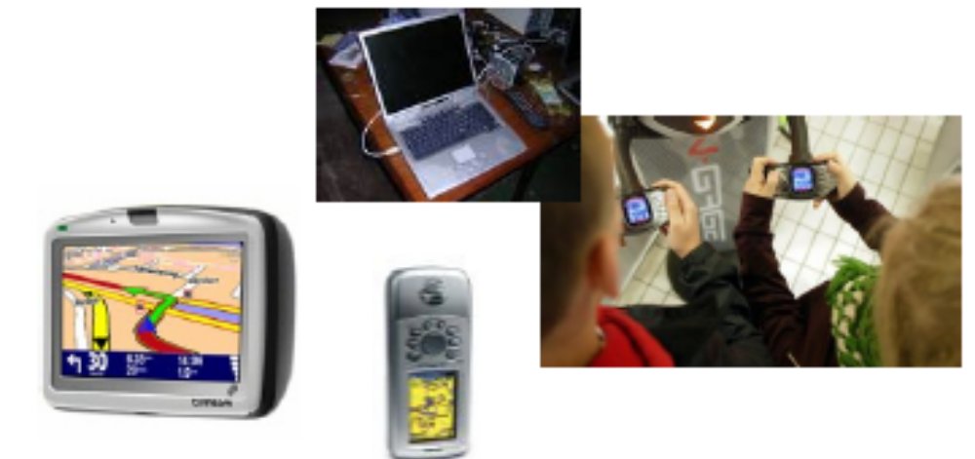
Why does it matter?
Because computers are everywhere

Slide 9
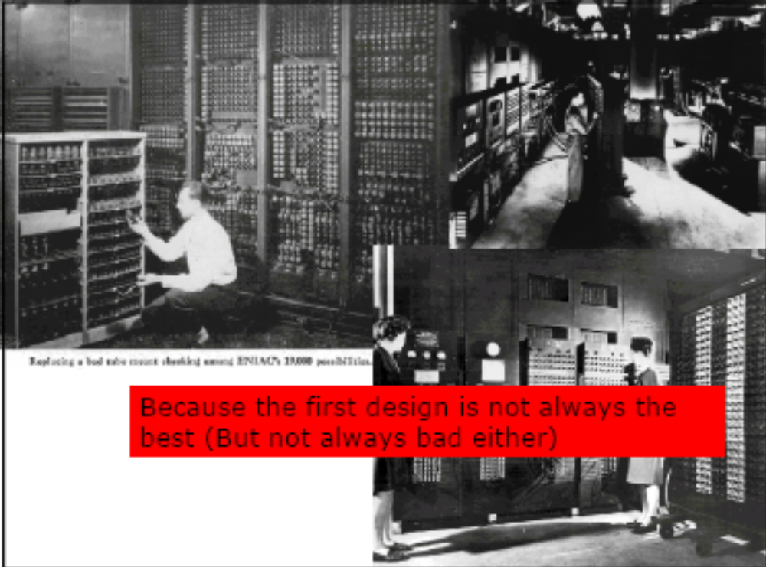

Slide 10
Saving money through better design
Around 63% of software projects exceed their cost estimates
–Top four reasons are
- Frequent requests for changes from users
- Overlooked tasks
- User’s lack of understanding of their own requirements
- Insufficient user analysis, communication, understanding

Slide 11
Why study HCI? Because there is an increasing demand for HCI experts
Recent salary survey by Usability Professionals Association - average salary for the UK survey respondents (n763) is £40.000.
http://www.usabilityprofessionals.org/usability_resources/surveys/2005_upa_salary_survey.pdf
“The combined UK usability and accessibility market will be worth more than £100m in 2005, according to new research published by E-consultancy, the London-based internet marketing group.”
“Increasing demand for qualified HCI professionals – recruitment is a big issue.”

Slide 12
Types of Decisions
What kinds of decision do we want to be able to make?
Selection
  Which available system is best?
• Evaluation
  How good is this specific system?
  Where are the problems?
Design
  How should the desired system work and look?

Slide 13
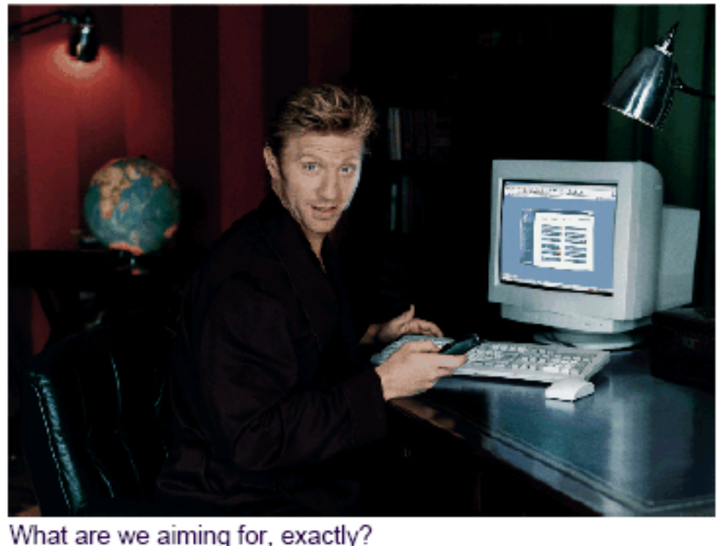
Evaluation Criteria 1

Slide 14
Evaluation Criteria 2
According to what criteria should we evaluate systems?
1.Speed of execution
  How quickly can U perform tasks with S?
2. Speed of learning
  How quickly can U learn to perform tasks with S?
3. Number and severity of errors
  How often do errors occur, and how serious are they?
4. Mental load
  Does U have to think carefully and keep a lot of information in mind while using S?

Slide 15
Evaluation Criteria 3
5.Functionality
  How many different tasks U perform with S?
6. Quality of results
  How good are the results of U’s task performance with S?
7. Robustness
  How well can S deal with unusual situations?

Slide 16
Evaluation Criteria 3
8.User satisfaction
  How well does U like using S?
9. Productivity
  Does S increase U’s work output, relative to
U’s work input?

Slide 17
Types of Factor
1.Physical factors
  Are U’s actions physically difficult?
  Are S’s messages easily perceivable?
2. Interface factors
  Can U perform his actions in a direct and natural manner?
  Does S tell U what U wants to know?
3. Social factors
  Does S fit into the social context in which it is used?

Slide 18
Some Design Examples

Slide 19
Some Design Examples
What examples of good and bad design
can you think of?
  Take a couple of minutes to discuss with neighbour
your example
what makes it good, bad
Feedback & short discussion

Slide 20

Some problematic designs
How fast am I going?

Slide 21
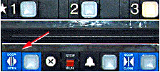
More problematic designs
How do I get out of the lift?

Slide 22
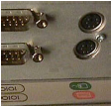
More and more problematic designs
Where does the mouse go?

